Slide 1


Session_10
By Eng-Adham Khaled

Slide 2



Slide 3

Why use excel?
Tables
Data organization
Calculation

Slide 4

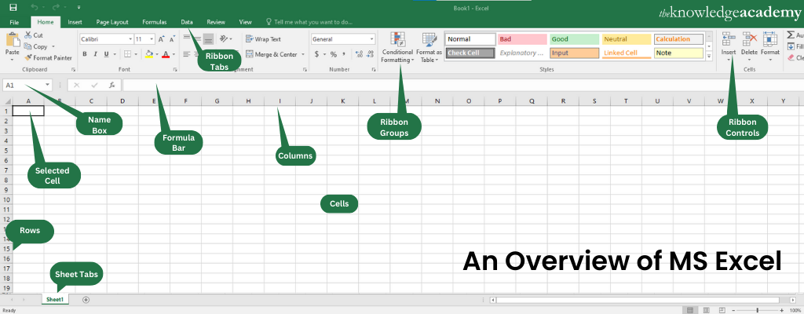
word-Screen layout

Slide 5
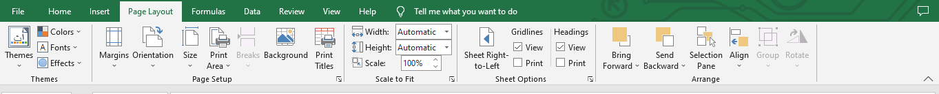
Page layout
Start from left to right if you will write English
Start from right to left if you will write Arabic

Slide 6
word-Screen layout
Most features in ribbons have same properties as word and power point:
File
Home
Insert

Slide 7
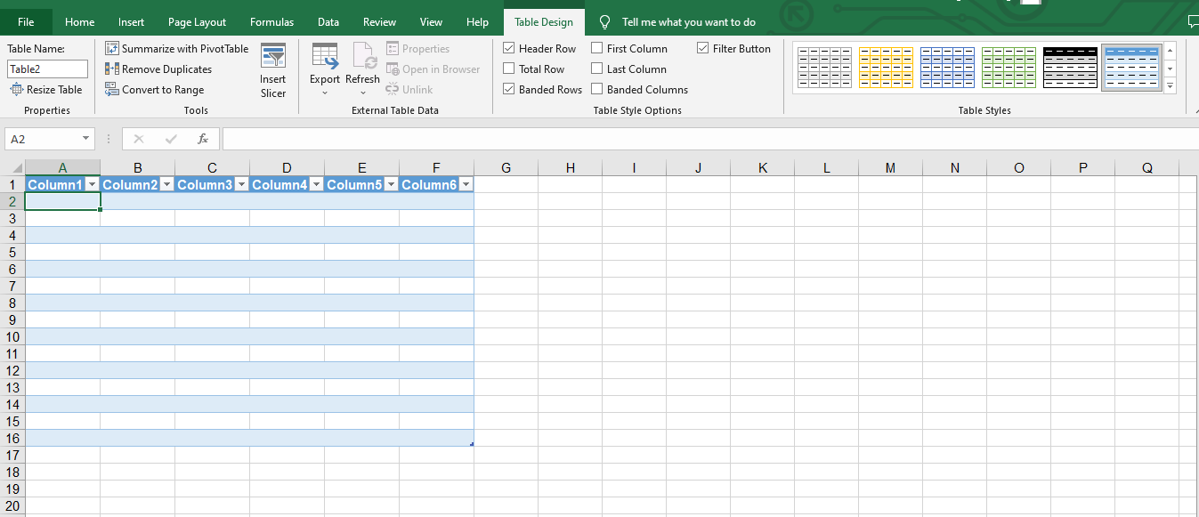
Table from insert

Slide 8
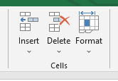
CELLS

Slide 9
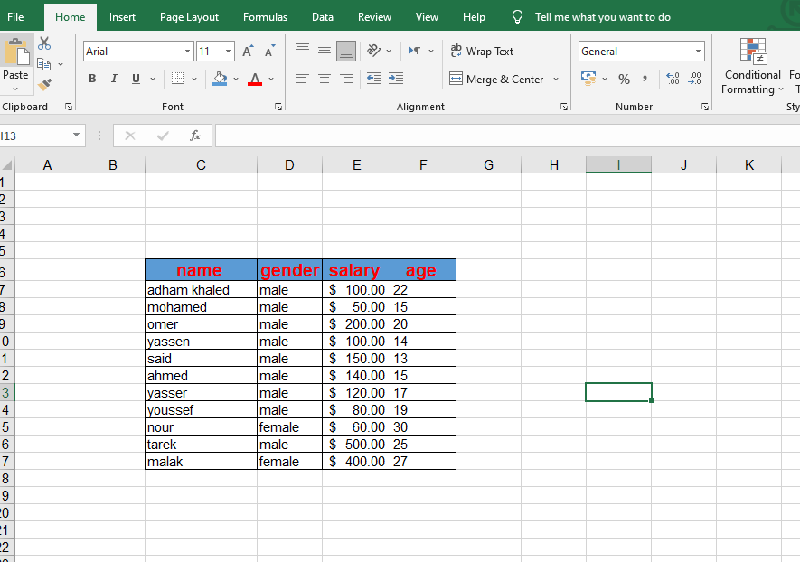
Task 1

Slide 10
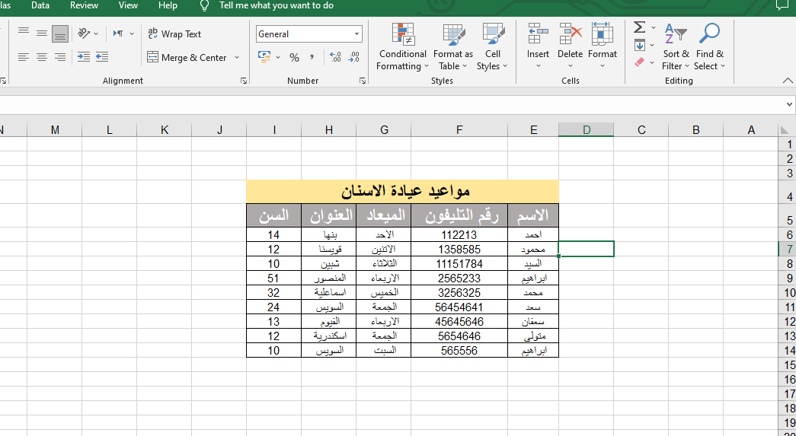
Task 2

Slide 11
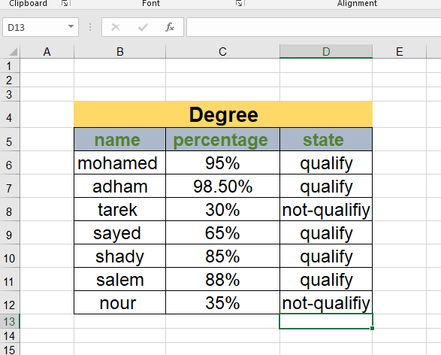

Homework

Slide 12


